Slide 1
Cartography with QGIS and R
Feb 22nd 2023

Slide 2
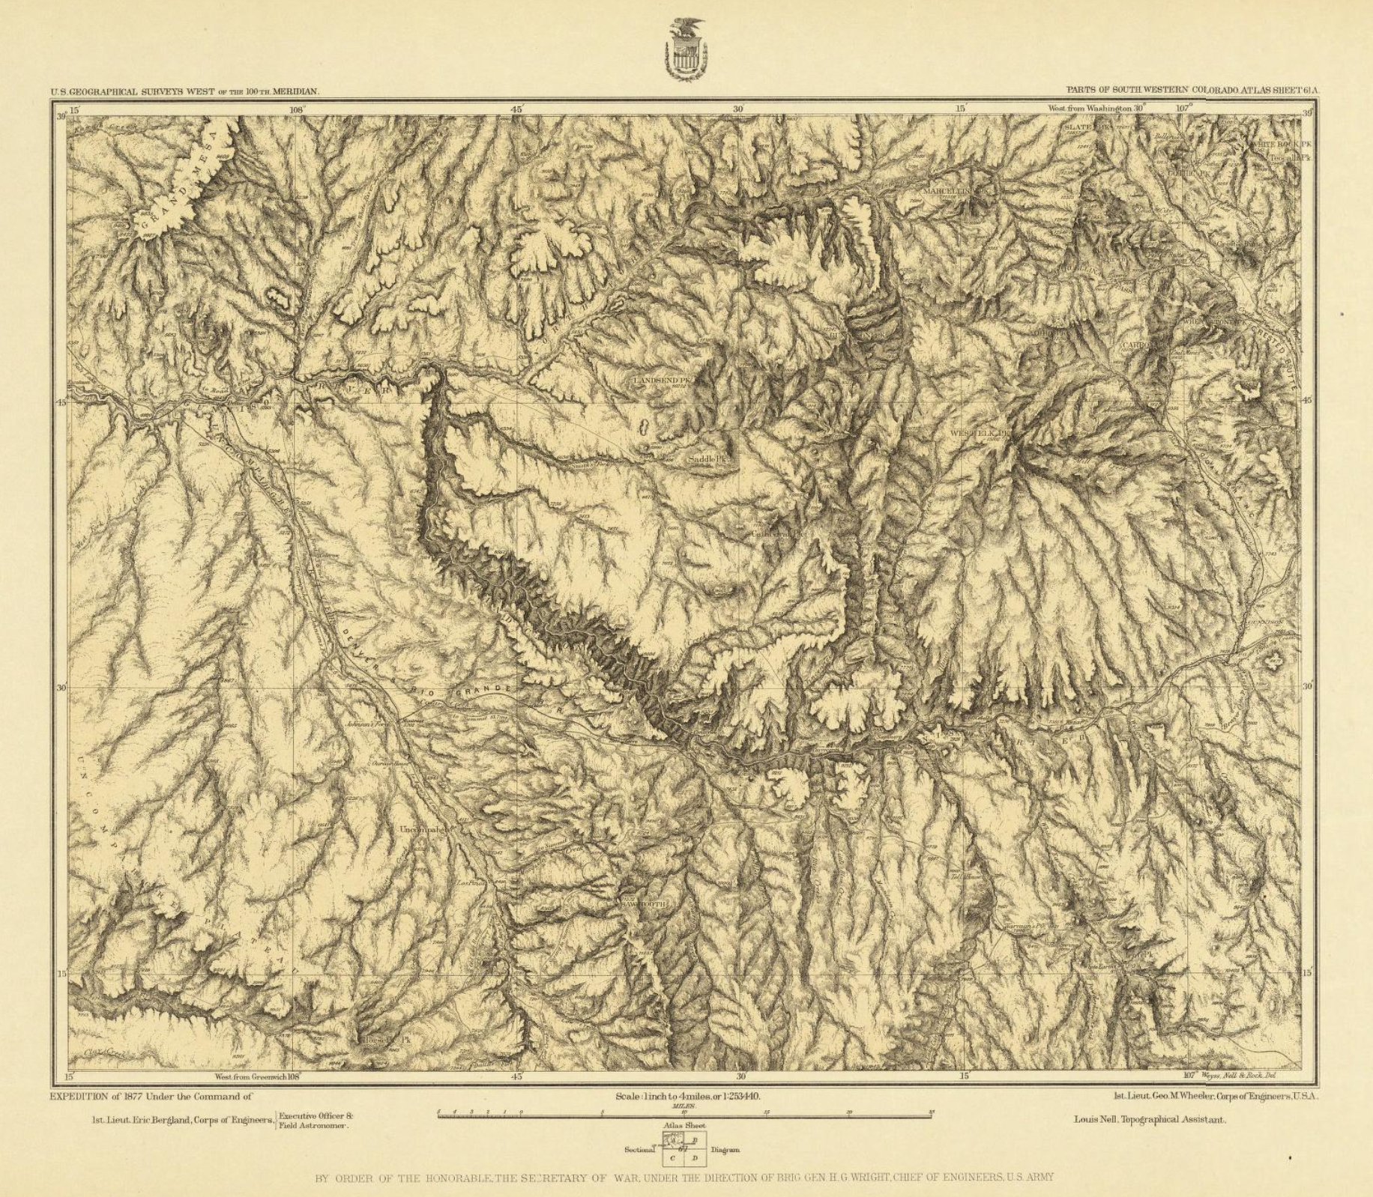
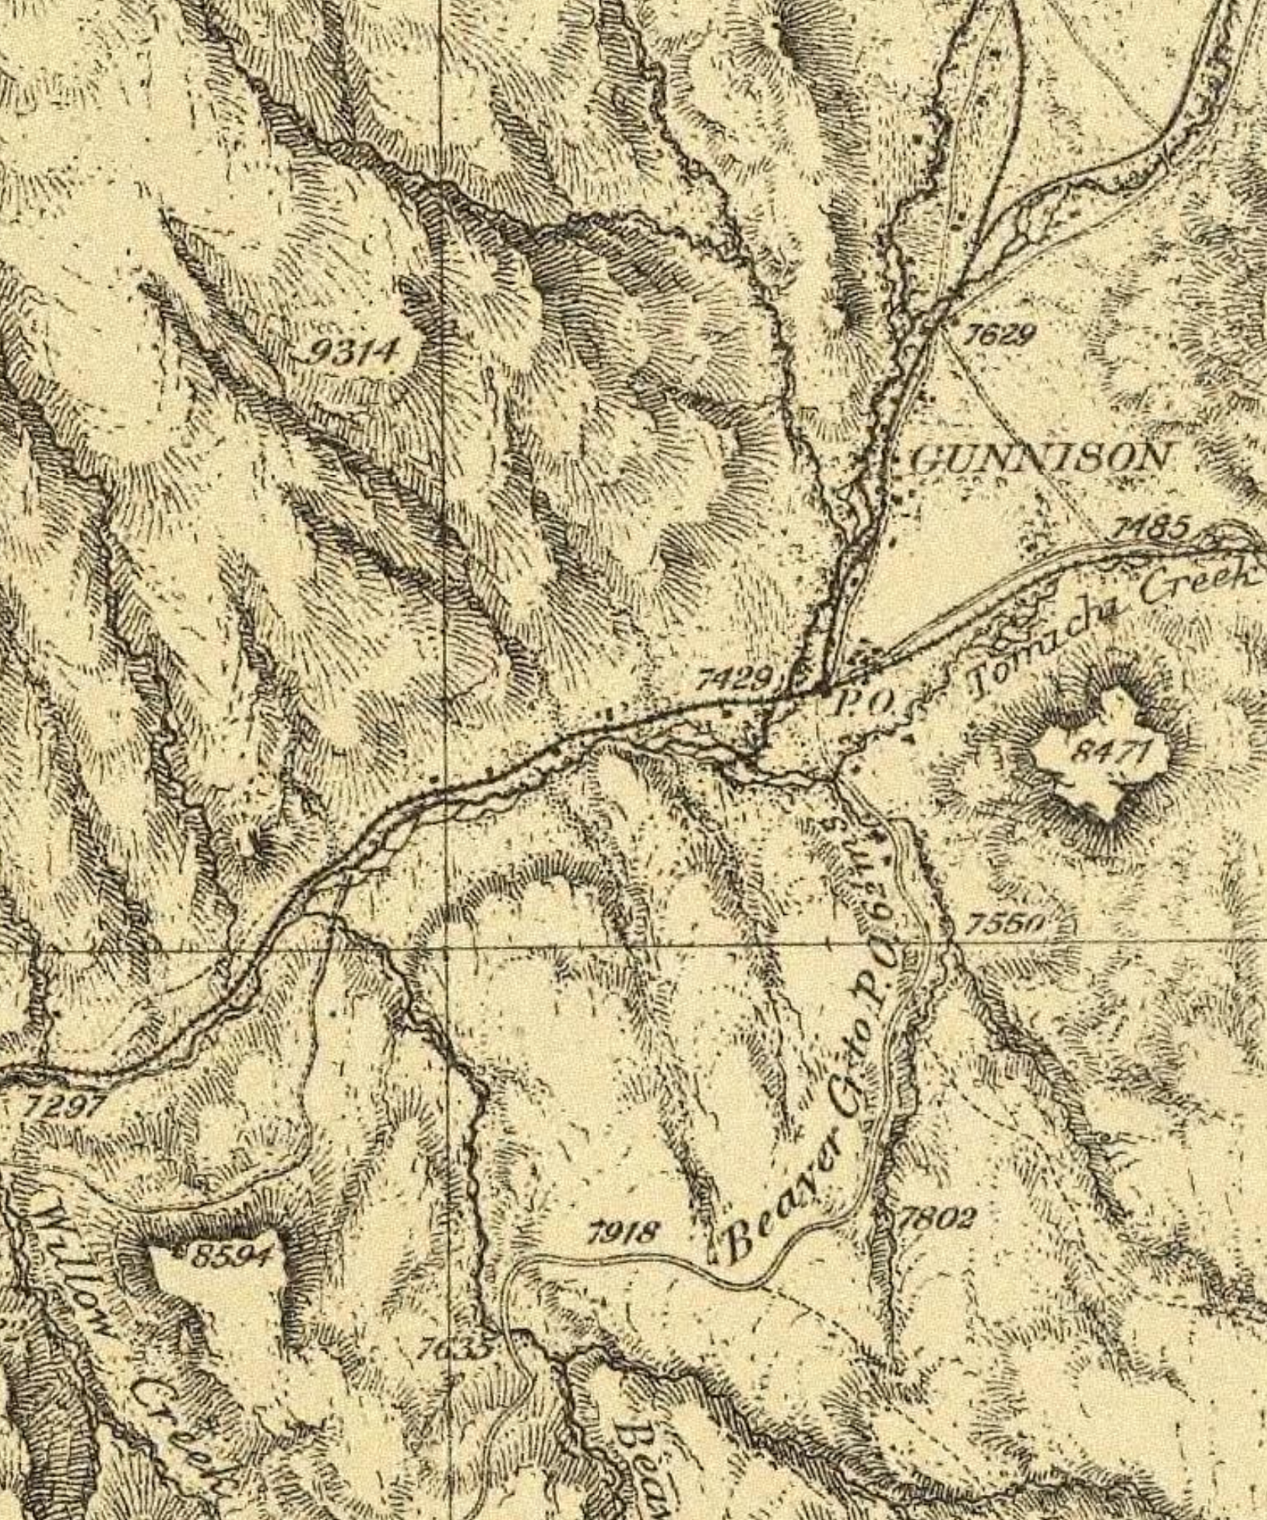
Cartography is Old
“language” changes
Black Canyon of the Gunnison, 1877

Slide 3
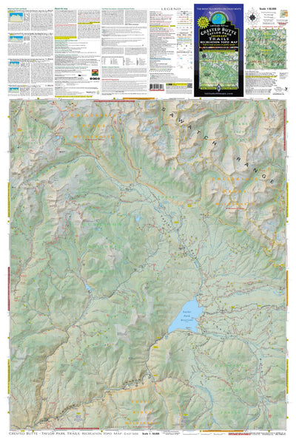
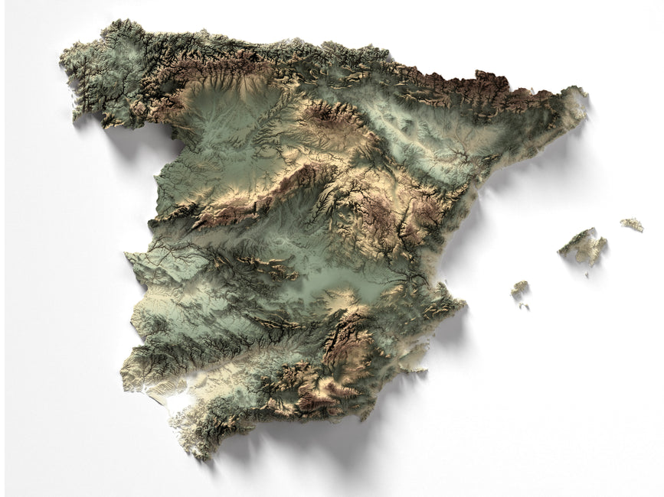
Maps for Reference vs. Art vs. Science

Slide 4
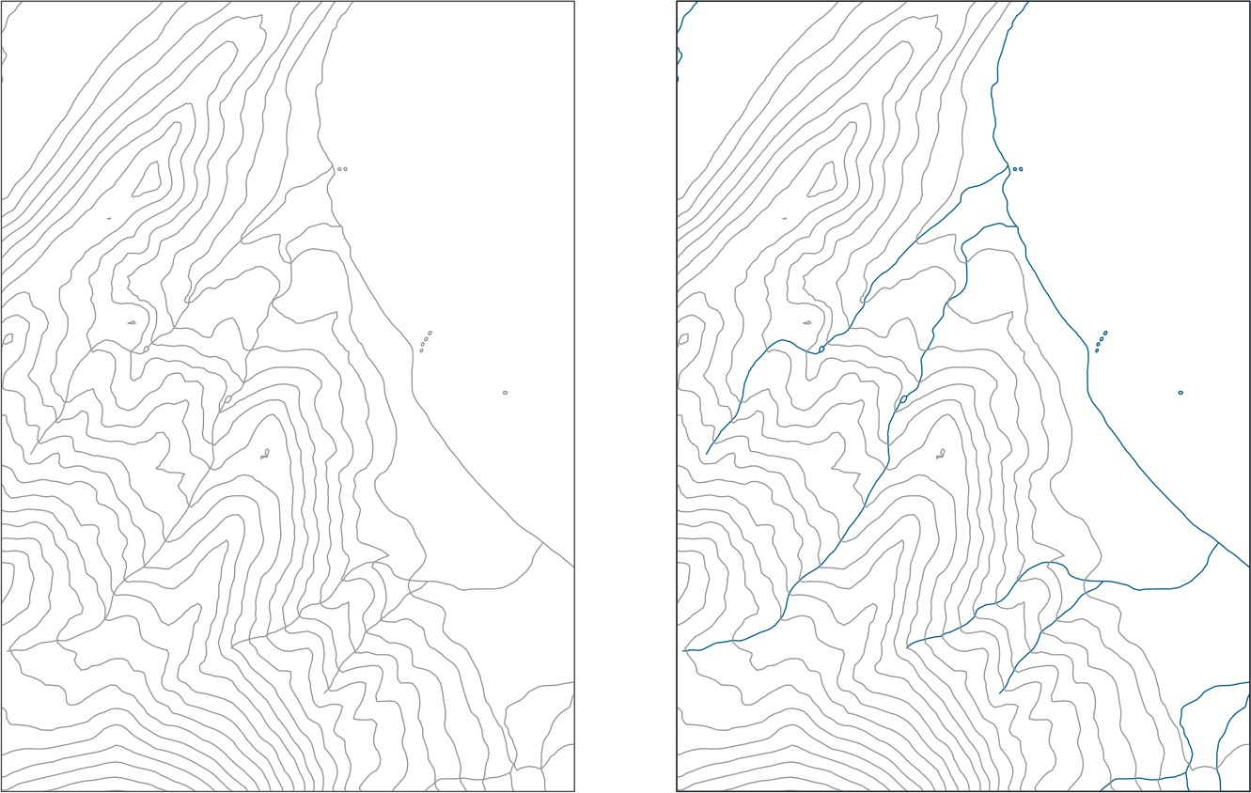
Visual Hierarchy
Bad
Good

Slide 5
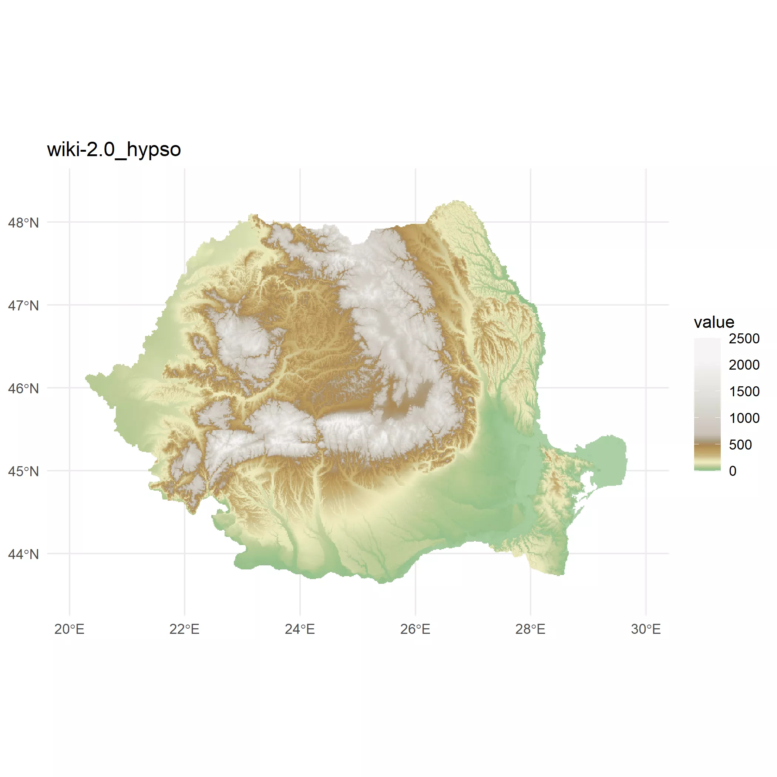
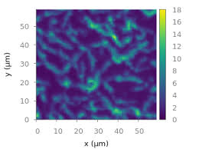
Appropriate Color Scaling

Slide 6
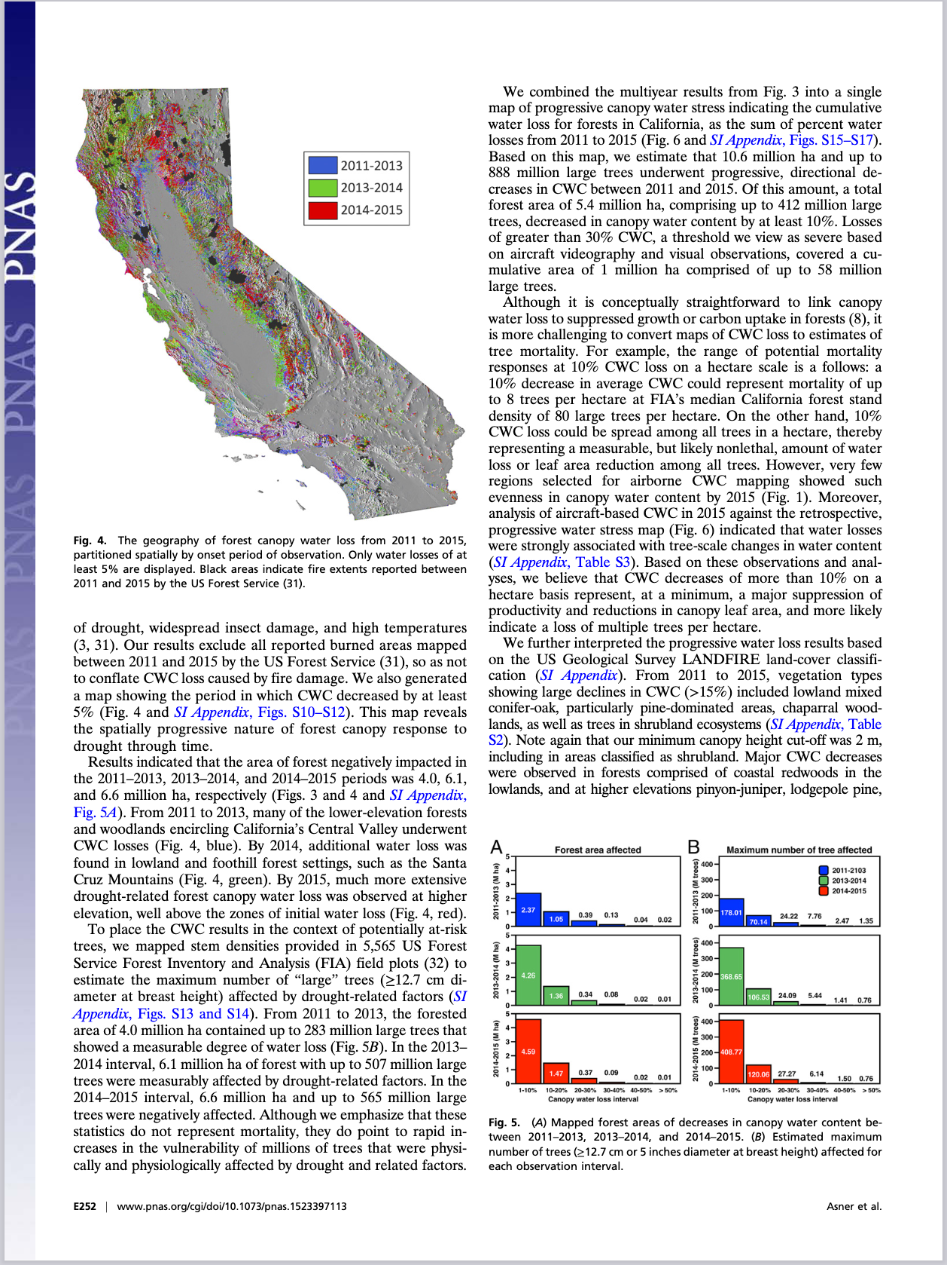
Small, Sparse Design

Slide 7
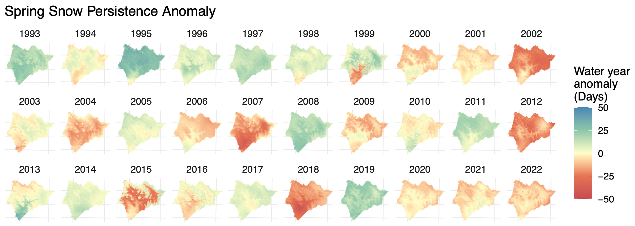
Small Multiples

